Slide 1
Rethink SCOM alerts
Kevin Justin

Slide 2

Recording Session is in Progress
If you prefer us not to include you in the recording, please drop off now.

Slide 3
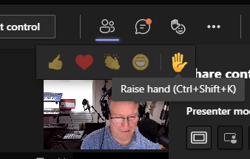
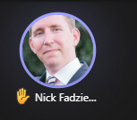
Questions during the session
Ctrl+Shift+K is a quick way to raise or lower your hand
In a regular teams meeting, please use the “Raise Your Hand” feature if you want to ask a question versus posting it in the chat window

Slide 4
Microsoft Confidential

Slide 5


Welcome to
Microsoft SPARK FY22H2!
For the field, by the field
Microsoft SPARK is a virtual learning conference open to all Microsoft internal employees, with a target audience of field individual contributors in Services, Sales and Support. Join us for your choice of 700+ peer led learning sessions across 7 solution areas and 66+ tracks – There is truly something for everyone!
This is an opportunity to exercise a growth mindset, learn with your peers, build connections across time zones, and hear new perspectives and solutions. Content will include delivery management, technical sessions (100-400+ level), diversity and inclusion topics, engineering releases, industry specific sessions, VIP speakers and much more.
For more information on additional sessions, content recordings, and slide decks, visit http://aka.ms/MicrosoftSPARK

Slide 6
Session learning objective
At the end of this session, you should be better able to…
Utilize pre-built insights
2) Leverage PowerShell framework scripts to consolidate key insights
Notes:
This slide is required. Do NOT delete. This should the first slide in your presentation after your session opening.
This slide should be part of your session opening and introduce what the learner will be better able to do as a result of attending this session.
You should have no more than 3 learning objectives for your session. Best practice: 1 Learning objective for 60 minute session. Aim for depth vs. breadth.
Good learning objectives should be learner centric, start with a verb (e.g., articulate, demonstrate, deliver, architect, troubleshoot, design) and be S.M.A.R.T (specific, measurable, achievable, realistic, time-bound). The learning objective should define a desired learner behavior (NOT what you are going to present).
The learning objectives on this slide should match those defined and published for your session on the SPARK session submission form.

Slide 7
The monitoring challenge

Slide 8
Rethink SCOM alerts
The monitoring challenge
Every customer (whether premise, hybrid, cloud) need key insights, and typically lack staff to execute timely alert resolution.
‘Rethink’ alerts to help customers derive value on existing monitoring investments
Not just SCOM, but Azure tool suite > into Log Analytics
Help customer transform action/resolution scenarios to resolve operational issues
Use automated workflows to decrease IT labor
Demo and test new monitoring workflows
Reduce false positive alerts
Utilize daily reports for owners to quickly consume problems/insights/trends
Automate common work efforts into reports, alert closures, and improved workflow diagnostic/recovery tasks
Notes:
Rethink began with a customer story
Reports also help CE focus resolution efforts for App/System owners on key problems in the customer environment

Slide 9
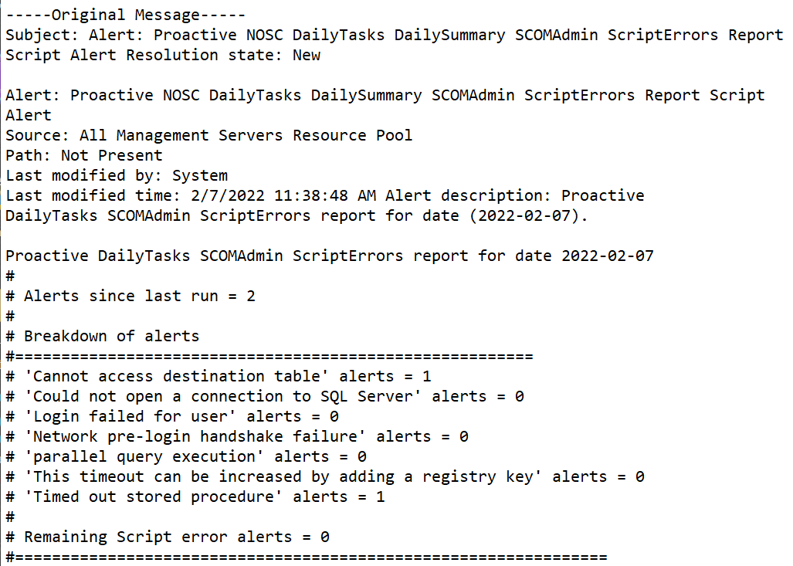
Rethink SCOM alerts
The monitoring challenge
Every customer (whether premise, hybrid, cloud) need key insights
Example
SCOMAdmin ScriptErrors report
Improve pre-built insights
Tailor to customer issues
Summary reports
Automated closure
Monitor/recovery tasks

Slide 10
Rethink SCOM alerts
Strategies to overcome
Break out pre-built insights
Application/System owner reports
Can include AppDev, NOC/NOSC/SOC, SysAdmin
Ex. AD, SharePoint, MECM, Virtualization/ESX/Vmware, McAfee, Tanium
Microsoft product reports:
Break out insights for multiple Microsoft products
Ex. ADDS, ADFS, SCOM admin, SharePoint, SQL, MECM, NiCE VMware
Proactive insights
Include ADFS, CRL, Expiring PKI certificates, Logical Disk, Pending reboots, not patched, not rebooted alerts
Other application alert scenarios
Filter out and count specific event criteria before alerting
Service recovery automation

Slide 11
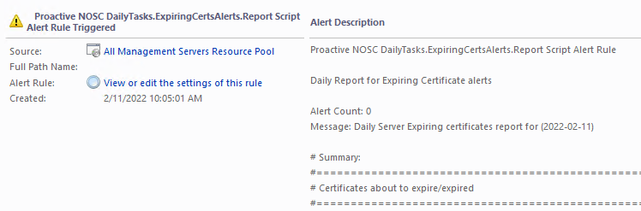
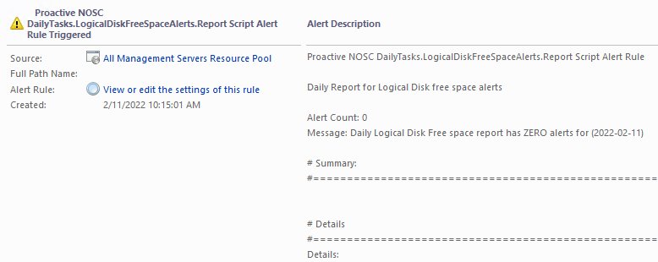
Rethink SCOM alerts
The solution
Report logic summarizes IT insights
What happened in the past 24-72 hours that require action or awareness
Automate various manual work efforts > help IT teams take action
Examples on right
Expiring Certificates
Logical Disk free space

Slide 12
Utilize pre-built insights

Slide 13
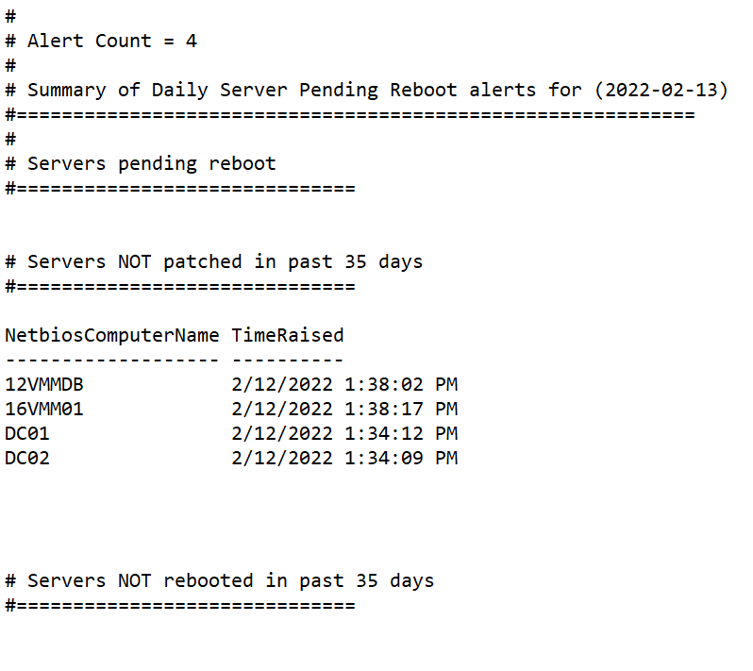
Rethink SCOM alerts
The solution
Build scripts to summarize IT insights
Example reports in Proactive.NOSC.Daily.Tasks.xml
ExpiringCertsAlerts
LogicalDiskFreeSpaceAlerts
PendingRebootAlerts
PendingRebootAlerts.ServerName
DailySummary
DailySummary.SCOMAlerts
SCOMAdmin.LongrunningScripts

Slide 14
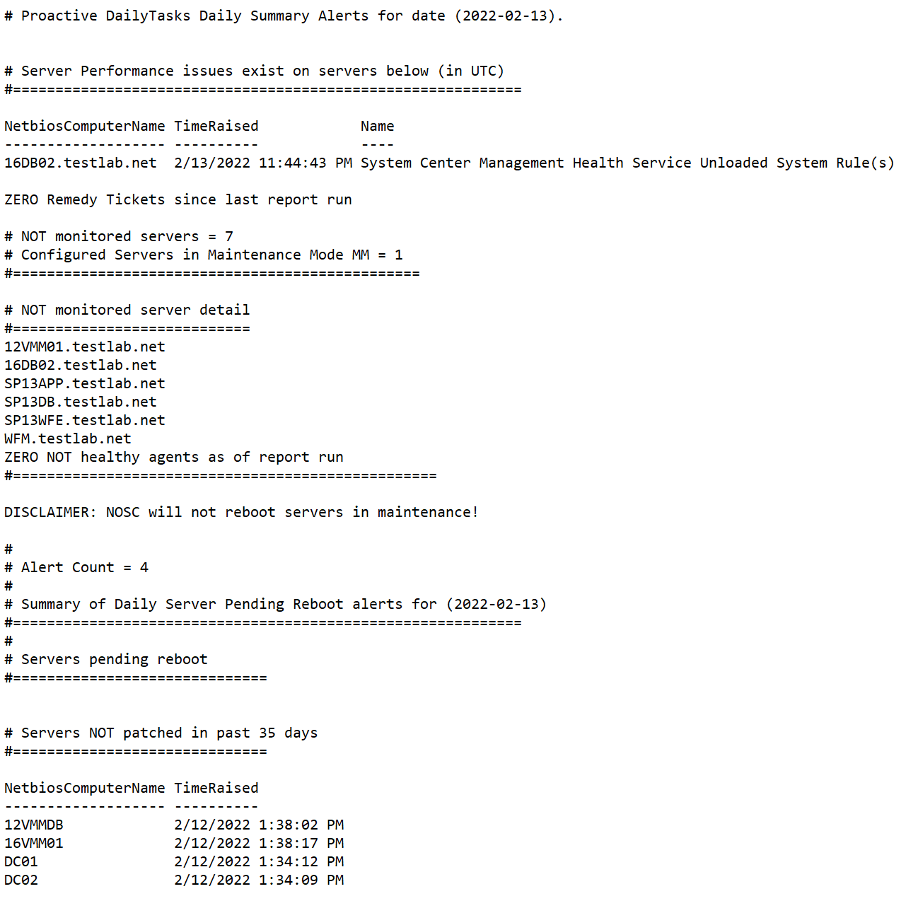
Rethink SCOM alerts
The solution
Summarize multiple insights
Daily Summary insights contained in Proactive.NOSC.Daily.Tasks.xml
Includes:
Server performance issues
NOT monitored agents
Expired certificates
Logical Disk full
Pending reboot/not patched/not rebooted
DC Alerts for role failures, SysVol, LSASS, Replication
Windows DNS
Group Policy

Slide 15
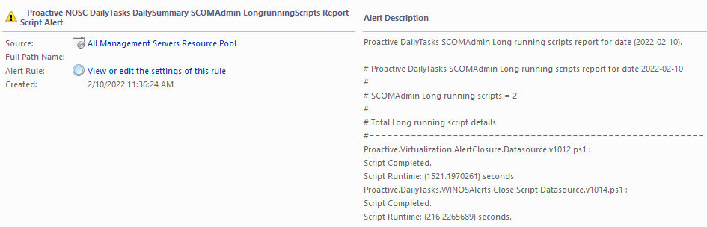
Rethink SCOM alerts
The solution
Build scripts to summarize IT insights
SCOMAdmin.LongrunningScripts insights contained in Proactive.NOSC.Daily.Tasks.xml
Includes:
Searches for Proactive DS/WA script runtime totals
Help Admin assess script performance AND SCOM management group performance

Slide 16
Rethink SCOM alerts
The solution
Build scripts to summarize IT insights
SCOM Admin insights indicating SQL issues
-----Original Message-----
Subject: Alert: Proactive NOSC DailyTasks DailySummary SCOMAdmin ScriptErrors Report Script Alert Resolution state: New
Alert: Proactive NOSC DailyTasks DailySummary SCOMAdmin ScriptErrors Report Script Alert
Source: All Management Servers Resource Pool
Path: Not Present
Last modified by: System
Last modified time: 2/7/2022 11:38:48 AM Alert description: Proactive
DailyTasks SCOMAdmin ScriptErrors report for date (2022-02-07).
Proactive DailyTasks SCOMAdmin ScriptErrors report for date 2022-02-07
#
# Alerts since last run = 2
#
# Breakdown of alerts
#========================================================
# 'Cannot access destination table' alerts = 1
# 'Could not open a connection to SQL Server' alerts = 0
# 'Login failed for user' alerts = 0
# 'Network pre-login handshake failure' alerts = 0
# 'parallel query execution' alerts = 0
# 'This timeout can be increased by adding a registry key' alerts = 0
# 'Timed out stored procedure' alerts = 1
#
# Remaining Script error alerts = 0
#================================================================

Slide 17
Rethink SCOM alerts
The solution
Build scripts to summarize IT insights
SCOM Admin insight detail
# Cannot access destination table detail
#=======================================
TimeGenerated EventID Message
------------- ------- -------
2/5/2022 10:16:38 PM 31551 Failed to store data in the Data Warehouse. The
operation will be retried.Exception 'InvalidOperationException': Cannot access
destination table 'Event.EventStage'.
One or more workflows were affected by this.
Workflow name: Microsoft.SystemCenter.DataWarehouse.CollectEventData
Instance name: SCOMMS.fqdn
Instance ID:
{807935E6-86F5-F3F2-825B-C810760A5862}
Management group: OPSMGR

Slide 18
Rethink SCOM alerts
# Failed to install MECM application packages = 0 # Tangible ProV alerts = 0 # DFS-R alerts = 1 # DNS alerts = 209 # DHCP alerts = 0 # Group Policy alerts = 1 #=================================================== # Servers Pending Restart = 2 # Servers NOT rebooted= 0 # Servers NOT patched = 0 # Group Policy alerts = 1 # Total remaining alerts = #=================================================== # Monitoring Health #=================================================== # Servers in Maintenance mode = 0 # Unhealthy Agents = 4 # Down agents = 0 # Repeatedly Down agents = 2 # Other Agent failures since last report = 3 #===================================================
The solution
Build scripts to summarize IT insights
Proactive DailyTasks AD Team Report
Alert: Proactive DailyTasks AD Team Report Script Alert Rule Source: All Management Servers Resource Pool Path: Not Present Last modified by: System Last modified time: 2/16/2022 10:03:50 AM Alert description: AD Team Daily report for (2022-02-16) AD Team Daily report for (2022-02-16) # ADDS Team Daily report for 2022-02-16 # # Alerts since last run = 644 # # Total OPEN alerts #=================================================== # AD Team alerts = 215 # Server performance alerts = 0 # Logical Disk full alerts = 1 # PKI expired certificate alerts = 0 # PKI Intermediate certificate alerts = 0 # PKI Root certificate alerts = 0

Slide 19
Leverage PowerShell framework to consolidate custom insights

Slide 20
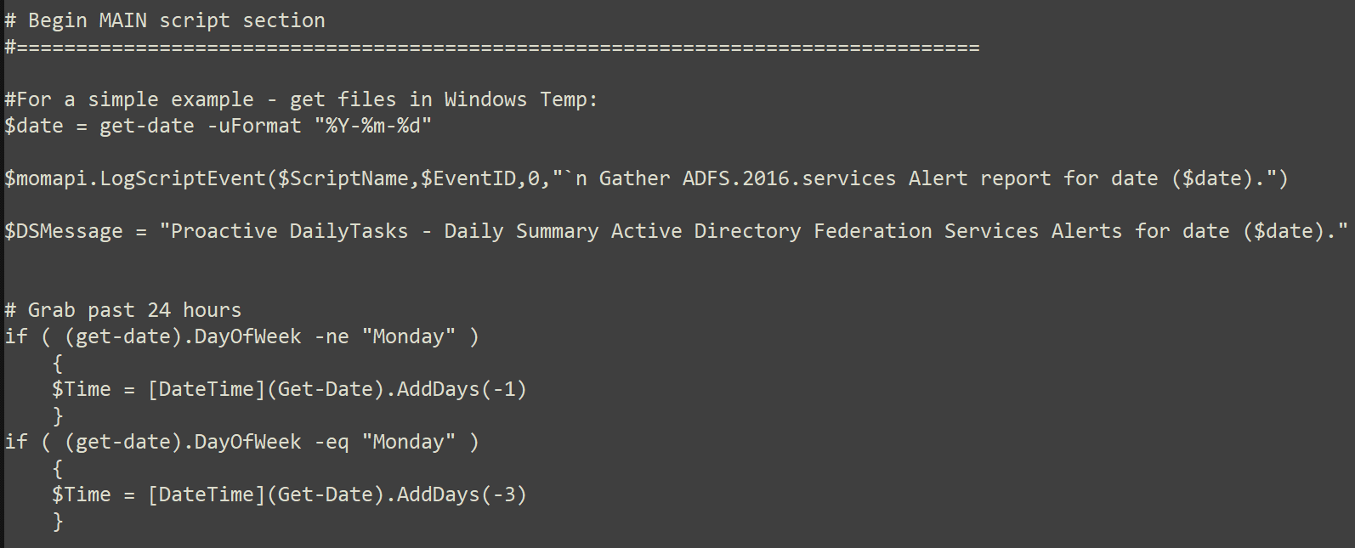
Rethink SCOM alerts
The solution
Build scripts to summarize IT insights
Leverage Time to help owners determine what happened in the past 24-72 hours that require action or awareness
ADDS example of time check built into the DataSource (DS)/WriteAction (WA)

Slide 21
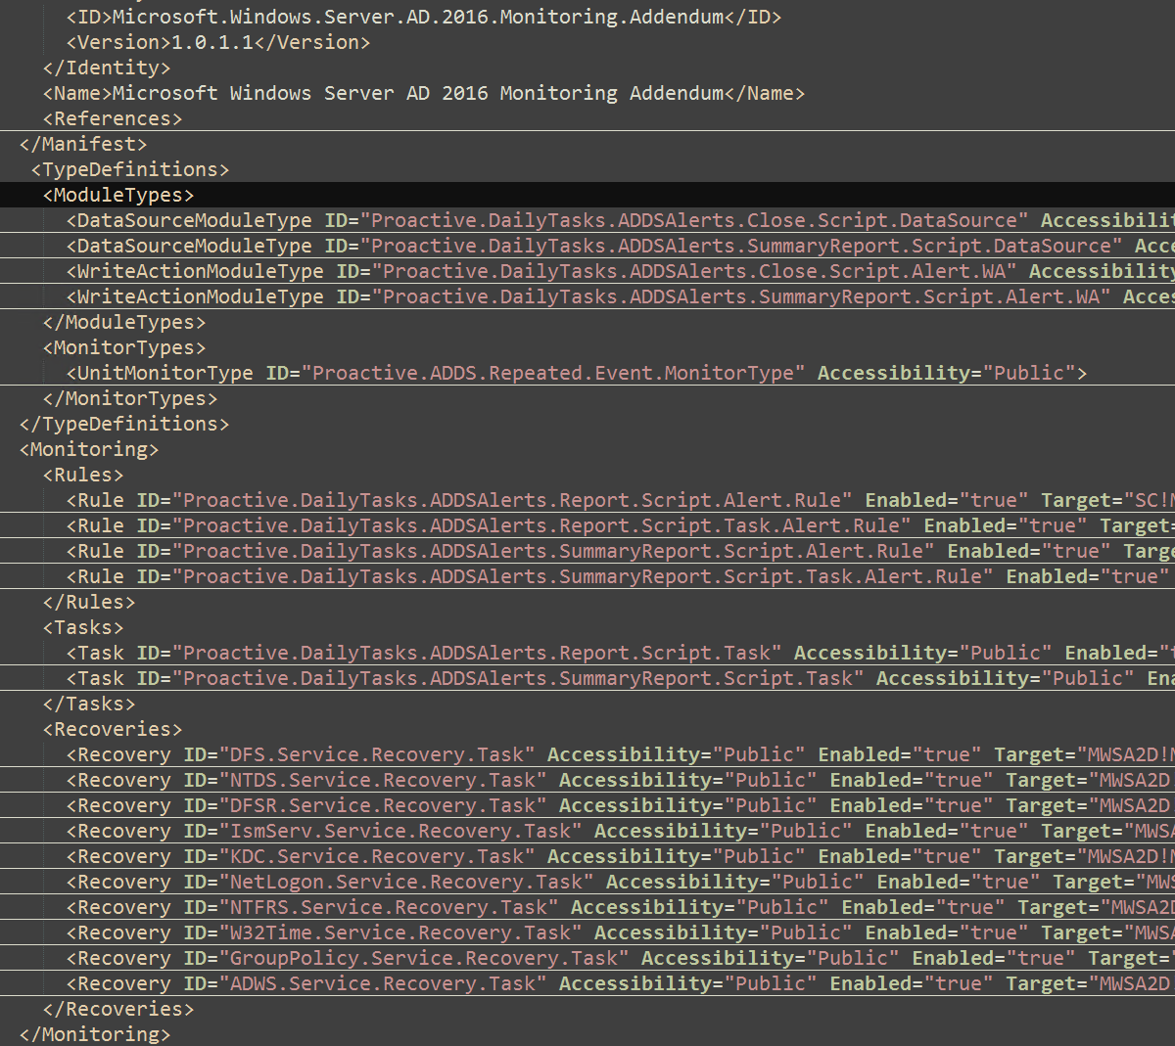
Rethink SCOM alerts
The solution
Build scripts to summarize IT insights
ADDS example with built in service recoveries, manual report tasks, and repeated events MonitorType
DataSource (DS)/WriteAction (WA) rules and tasks to schedule report delivery
Automate various manual work efforts > help IT teams take action via service recoveries
Improve 'how' workflows behave before alerting

Slide 22
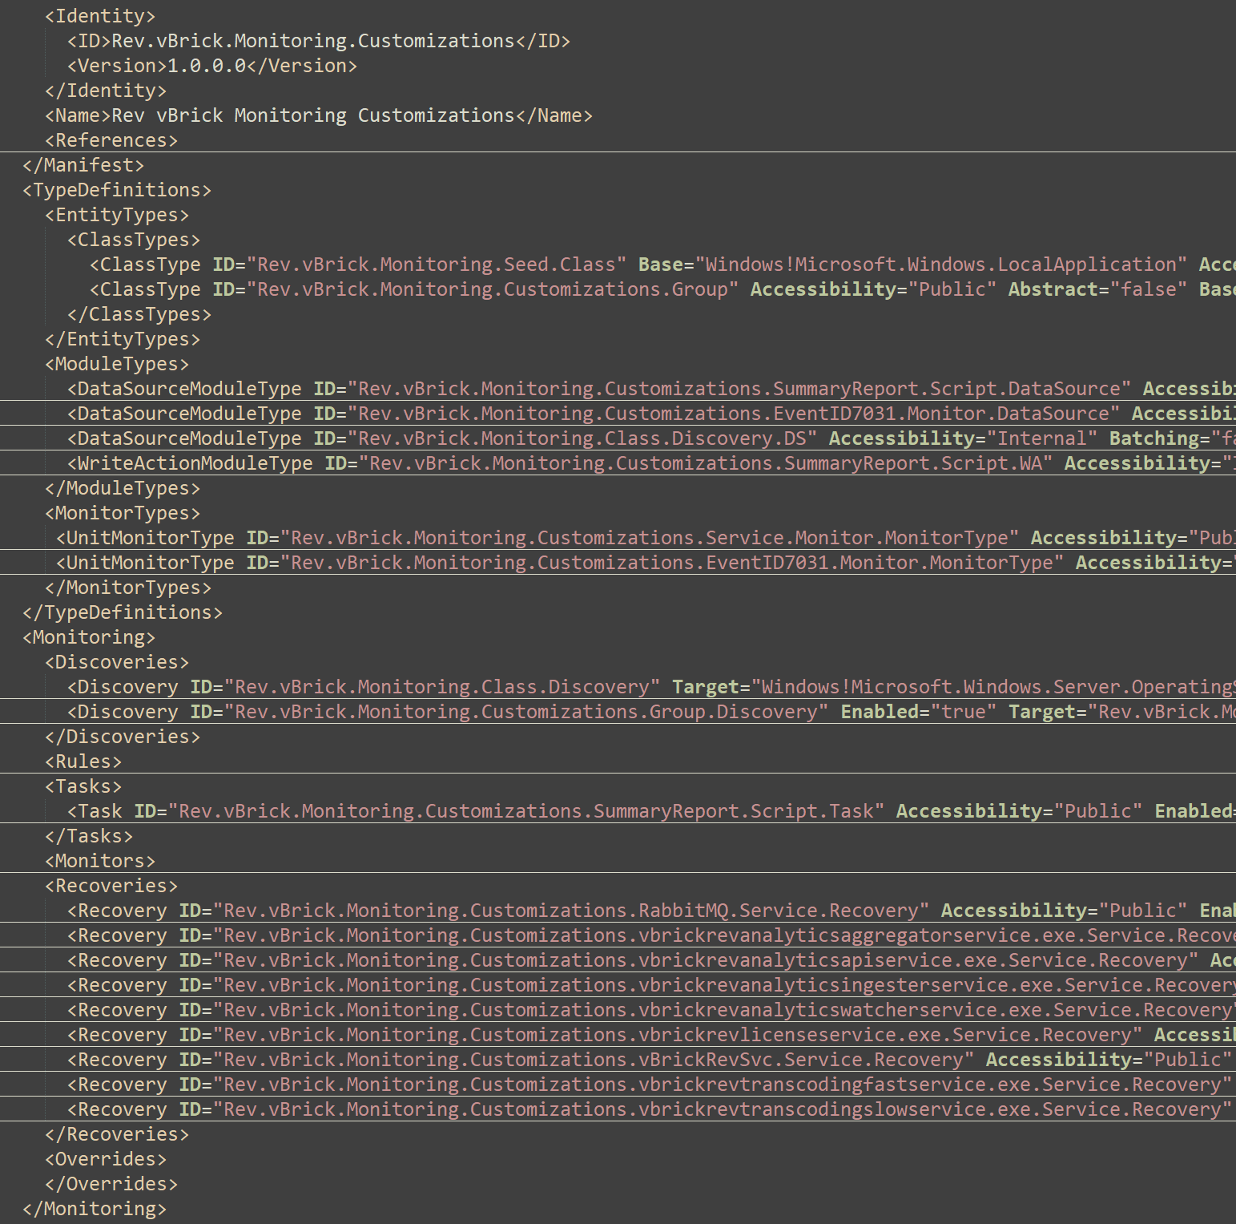
Rethink SCOM alerts
The solution
Build scripts to summarize IT insights
Rev vBrick webcast example contains service recoveries, manual report tasks, and repeated event ID 7031 monitortype
Use automation to reduce manual work efforts
Service monitortype includes Samples, IntervalSeconds
Recoveries include taskkill in service restart automation

Slide 23
Conclusion

Slide 24
Rethink SCOM alerts
The solution
Moving forward
Build/test scripts with SCOM/Azure Automation workflows into AzMon
Include IIS alert report, scoping discoveries, summary alert/closure reports
Add additional get-process diagnostic workflows to identify offending process(s) taking CPU/Memory
Github Repo:
https://github.com/theKevinJustin/ReThinkSCOMAlerts
Other internal efforts that compliment 'rethink' alerts:
Tadd Dawson's Spark session 'Getting Comfortable with Custom Objects in PowerShell'
https://github.com/TaddEDawson/ComfortableWithPSCustomObjects
Hugh Scott's Alert Management pack https://monitoringguys.com/2021/06/10/scom-alert-management-pack-overview/
Kevin Holman's MP Authoring fragments https://kevinholman.com/2019/01/17/mp-authoring-with-fragments-introducing-combo-fragments/
Kevin Holman MP fragment GitHub https://github.com/thekevinholman/FragmentLibrary
Kevin Holman blog https://kevinholman.com/2016/06/04/part-1-use-vsae-to-create-a-new-management-pack-project/

Slide 25
Questions ???

Slide 26
Thank you to the SPARK team
This event could not happen without the army of volunteers who have dedicated their time over the months leading up to this week. The SPARK program would like to thank the following individuals for their support:
Core Team
Liz Tesch
Communications
Nicholas Orlando
Mark Grimes
Nick Fadziewicz
VIP Speaker Series
Ann Johnson
Operations
Aaron Gutierrez
Scott Kissel
Eunice Chinchilla
Steve Taylor
Misba Saleem
David Roman
Craig Riter
Srinivas Varukala
Fernanda Seika
Tools
•Brian Culver
•Craig Riter
•Arun Kumar
•Brandon India
•Chet Crosby
•Doug McInnis
•Emmanuel Nkanu
•Felicia Ju
•Jowoy Holmon
•Martin Estrada
•Md Ullah
•Mehak Vij
•Michelle Chuang
•Mike Swantek
•Mohammed Quadri
•Nate Chen
•Nicholas Orlando
•Nick Fadziewicz
•Raj Bhat
•Raji Subramanian
•Sam Shah
•Srinivas Varukala
•Sufyaan Kalota
•Suresh Swaminathan
•Tony Feissle
•Zenia Saqib
Liz Tesch
Alex Weinert
Uli Homann
Jason Zander
Panel session -Rob Lefferts, Nichola DiCola, Sue Bohn, Michael Wallent, Sarah Mocke
Track Owners
Speakers
Attendees
Almost 40 Track Owners managing over 400 sessions
More than 800 Speakers
Tens of thousands of Attendees, just like you!

Slide 27
Conference Feedback
Please take an opportunity to complete our survey
Helps get feedback on how to make the Event even better
Provide support for Microsoft SPARK so we can continue providing these types of events
Gives insights into the Microsoft SPARK stakeholders like the Product Group, Customer Experience teams, and others

Slide 28
Thank You

